Slide 1
SEJ – Scandinavia easy jet airline reservation system
group 5 Presentation
Members:
Dana Iliescu, Lei Xian, Felix Leber, Marius Ailisoaie

Slide 2

ITO: How does it benefit out our project?
Scandinavian Easy Jet (SEJ)
Analyzing a real company
Used real companies as inspiration
Notes:
We needed a company on which we could base our project on, and to reach a conclusion on whether the project is doable or not, so we made up Scandinavian Easy Jets (SEJ). We have never analyzed a company before, so doing all the steps of the ITO requirements and analyzing this company gave us an idea of how it is in the real world, even though the company is made up.

Slide 3
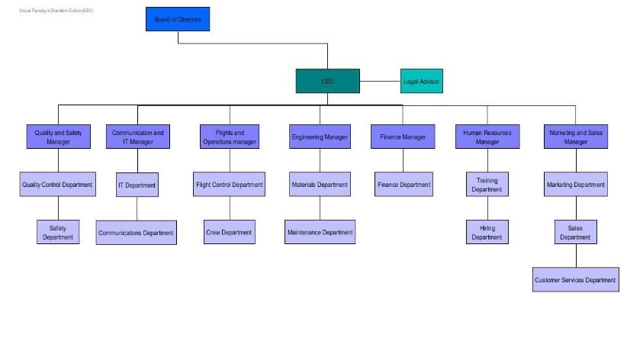
Organizational structure

Slide 4
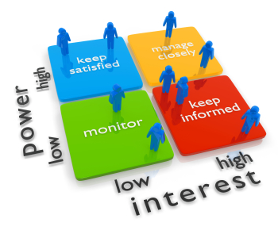
Stakeholders
Feasibility Study
Will help us in our future jobs

Slide 5
the Unified Process

Slide 6
UNIFIED PROCESS vs WATER FALL

Slide 7
Water fall?! why? We told you to use up!
Previous Projects were small and short
Requirements were relatively easy to detect
Water fall method works
We tried to use UP, but didn’t see obvious benefits

Slide 8
Unified process, why?
Project is big enough
Hard to capture all requirements at once
Information needed to build system is a lot
Not easy to start, we knew nothing about an airline company

Slide 9
Inception phase
Feasibility study
Vision
Glossary
Some use cases in brief

Slide 10
Elaboration phase
Capture the most requirements
Design the main structure for the system
Tackle the most difficult parts
Make or refine some artifacts

Slide 11
Construction phase
Refine the artifacts
Construct the rest of the requirements
Integrate all code
Test and debug

Slide 12
How did we plan the iterations
A list of clear goals
Stay in focus
Each group member is assigned a responsibility
Be short and realistic, not long and ambitious
New plan at the end
Notes:
Each of our iteration was quite short, and that was intentional. We didn’t want to make unrealistic approach. To avoid of being too ambitious, we planned small iterations. Each iteration had a list of goals, they were clear and doable. During the iteration, we focused on those goals, everyone got some tasks individually or grouped together with others, to reach the goal. When one iteration was done, we made the plan for the next iteration based on the same principle and what we had done.

Slide 13
Communication!
Feedback from customers (here, it is you, teachers! thanks For the feedback!)
Talk with group members! Discuss always!
Make sure we are agreed with /understood each other!
Dana will talk more about our team work.
Notes:
It is very important to have a good communication if one works for a real software development company. No matter if it is between you and your colleagues, or between you and your customers. Lack of communication can lead to serious failures. When we carried out the plans in each iteration, we tried to keep each other updated all the time of what we were doing, or discussing what we had in mind, in order to reach the efficiency.

Slide 14
What about those artifacts? Have we understood more about them now?
Notes:
Each iteration has generated some artifacts, we have always kept them updated throughout the whole project.

Slide 15
Use case is:
Like a good story
A start point for everything
To discover requirements
Influential to many aspects of the project
Notes:
A good use case is like a good start, that it can bring the project to the right direction. If one is able to write a good use case, it will help to understand what the system is used for, it will help to detect requirements, and to build domain model, to design a reasonable system. So it influences a lot of aspects of a project.

Slide 16
Why use case is important?
Get user involved regularly
Place user In the center
Help to focus on the user goal
Fully dressed format is helpful
Notes:
Why use case is important? Because use case are requirements. It allows you to stand on the users’ point of view, to find out how the system should be. It is about to deliver a system fits the users’ needs, not too much or too less functions. When requirements are difficult to detect, fully dressed format use case should be really helpful.

Slide 17
Use case example: UC#3 - book ticket
A person calls the company to buy a ticket/tickets
Employee finds the ticket according to the person’s requirement
Register the person’s information
Generate a ticket
Customer = passenger

Slide 18
How does it influence our decisions?
When it has not covered enough situations
Buy only 1 ticket?
Buy more than 1 ticket?
Buy ticket for one self?
Buy ticket for other people?
Notes:
When we wrote this use case in fully dressed format, we thought about the situation that a person tells the company the requirement for the ticket, and the employee would register the person’s information and then generate a ticket for him, so a ticket is booked. This person is a customer, he is also a passenger.
But we have not thought well enough about the alternative situations, and it became a problem later when we started to construct the code.
In reality, a person can buy ticket or tickets for others, then this person is a customer, but not a passenger. But our system can not handle this situation.
At the beginning of the Elaboration Phase, we actually had the discussion about customer and passenger, but we have decided in our system, a customer is a passenger, due to the consideration of the time. We thought this could make our work easier. But actually it was confusing. If we have wrote those situations in the alternative flow, we probably would decide to keep customer and passenger as 2 separate classes. Because in reality, this two may have nothing to do with each other.
Well, if we were dealing with a real project, such situation might be pointed out by the customers.
This is an example of where we can see how use cases influenced the decision of making code.

Slide 19
Three layered architecture
Clear structure
Avoiding direct contact with the data access layer
Focused responsibility
Maintainability
Notes:
As we worked through this project, we have gained a better understanding of this architecture, it is really nice and smart. It is very clear to see which layer is responsible for what. By putting the classes who share the similar/same responsibility to the same package, it gives a good structure of the code. This is important, especially when considering the maintainability of the code in the future. This is also related to GRASP, for example to apply the low coupling, high cohesion, and controller in the layer architecture is easier comparing to a non-layered architecture.

Slide 20
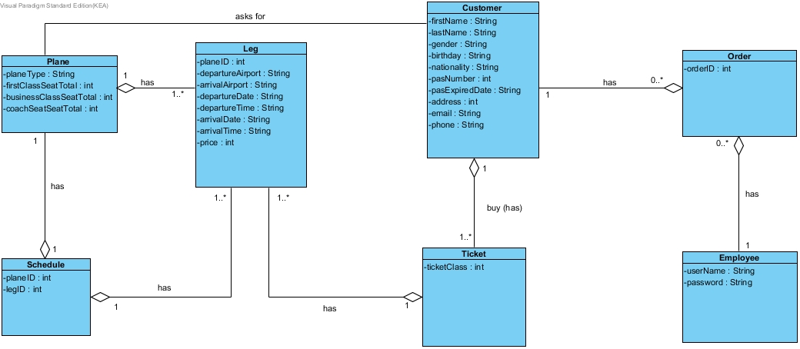
Domain Model

Slide 21
Class Diagram
Making and updating
Many changes, multiple versions, transition seen
More classes added and 3 layered architecture used
GRASP patterns used
Low coupling / High cohesion
Controller classes

Slide 22
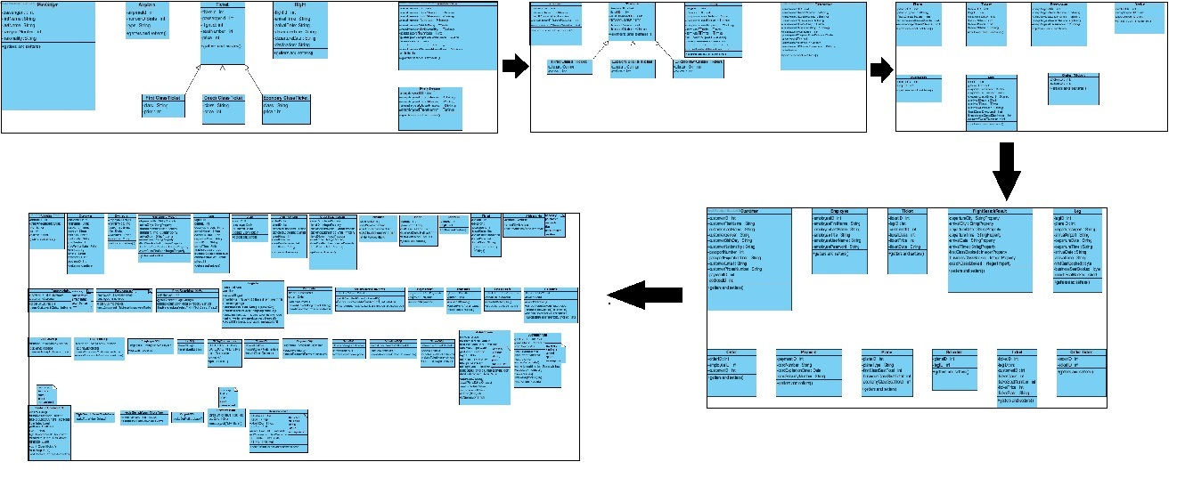
Class Diagram Transition

Slide 23
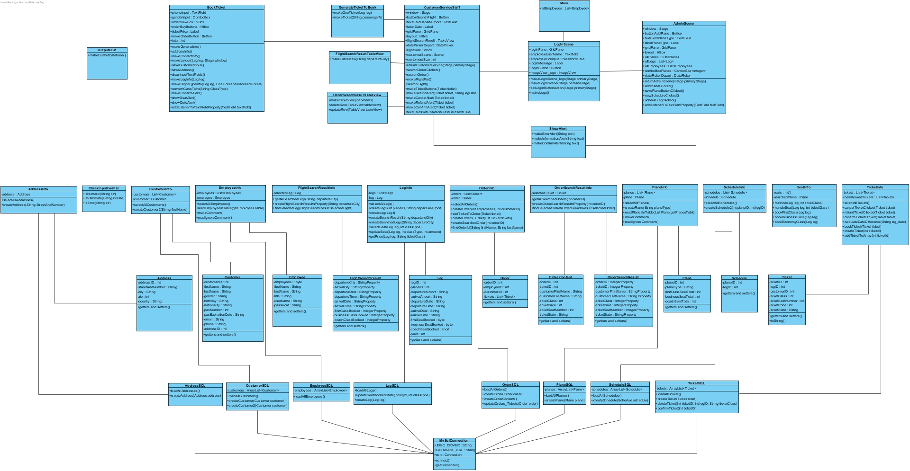
Class Diagram

Slide 24
Domain Model and Class Diagram
Corelation: the classes in the Domain Model became the DataType classes in the Class Diagram
Domain Model is business model that represents things in real world
Class Diagram contains each class that we need in our application.

Slide 25
USAGE OF DATATYPE IN JAVA
Memory management, less memory used
Efficiency improved
Faster application

Slide 26
DATA STRUCTURE using List<>
ArrayList<>
LinkedList<>
Advantages and disadvantages
Flexibility of organizing and structuring data
Notes:
ArrayList : better because we need to add at the end
LinkedList: better to remove from the beginning but we don’t need this feature / option
ArrayList : better for searching as you can access an element directly

Slide 27
What have we learnt?
The connection between the software design and the software construction
How a program/system is born
Behind the scene
Notes:
Such a project like this airline reservation system project has made us to see better what is the connection between the software design and the software construction. Now we have a more complete picture of how a program/system is born, or how much effort it takes. It is not always easy to apply or to combine the knowledge we have learnt, but it is exactly those challenges that enable us to understand deeper.

Slide 28
Team Work
Notes:
Lastly, I am going to talk about us, about what we as individuals gained from this project and about how we went from being a group to being a team, in order to get this project done.

Slide 29
Team ≠
Group
Coordination of tasks and activities for achieving a shared aim
Interdependence between members
Common purpose: getting the project done
Roles and duties are specified
Members know each other’s skills and capabilities
No particular outcome
The members can work disconnected from each other
Groups do not need a purpose, they can simply exist as a matter of fact
Structure is much more informal
Members have little knowledge of each other
Notes:
There are several ways in which groups differ from teams. The most important ones are: task orientation, degree of interdependence, purpose, degree of formal structure,
Familiarity among members.
Team members work together for a common goal and share responsibility for the team’s success, they have active participation in the discussions and they become interdependent, since they work together for a common output. None of this happens in a group. Groups do not need to focus on a specific purpose and individuals can work independently from one another.

Slide 30
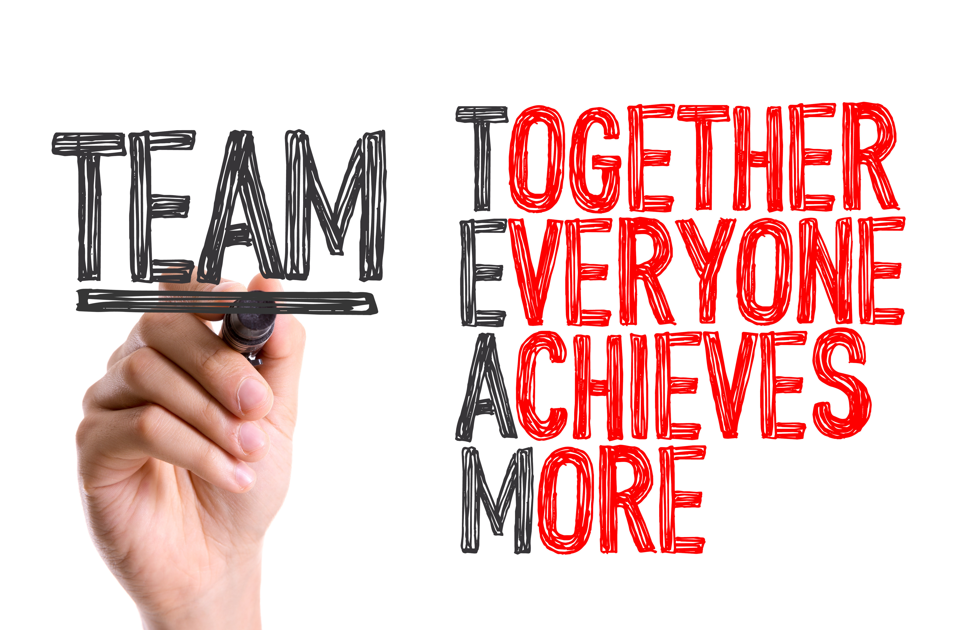
Becoming a Team
Use our knowledge
Combine skills
Exchange Ideas
Divide tasks
Make research
Be active!
Help!
Notes:
We formed our team by putting what we learnt in class to use, combining our skills, exchanging ideas and working closely together for the project. When a task had to be completed, if one of us was unsure or got stuck on something, the others would always help. An example of this was when we were fixing bugs in our code: all of us would take a look and try to find a solution. By this they would also understand the code, even though they didn’t code that part. When someone was a bit unsure about something , we would ask that person to explain to us what the problem is and then we would all think about what’s the best path to choose. Having this effective communication led to a good understanding of the project and good quality work. We also realized that we were much more productive when we worked together in the school after classes or in the library.

Slide 31
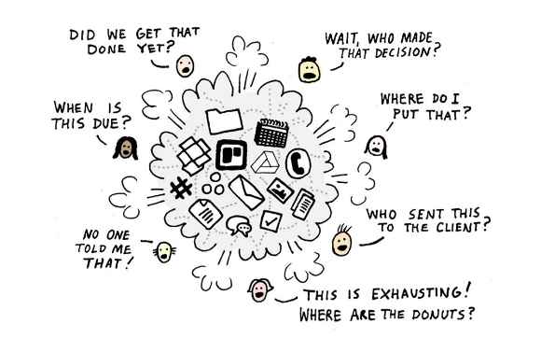
Basecamp – A helpful tool
Notes:
While conducting a project it’s very likely that things get messy and you might easily lose track of messages, documents and who has to do what.
We used Basecamp, a website based on the analysis of highly productive teams. People working together can organize and discuss everything they need to get a project done. Everyone is on the same page and up-to-date with the status of the project.

Slide 32
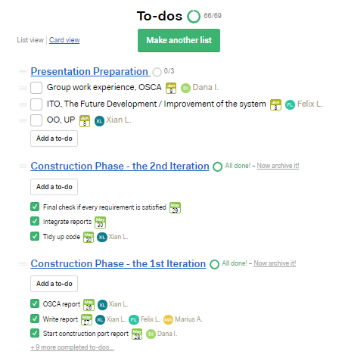
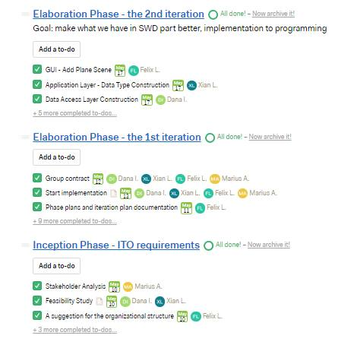

Slide 33
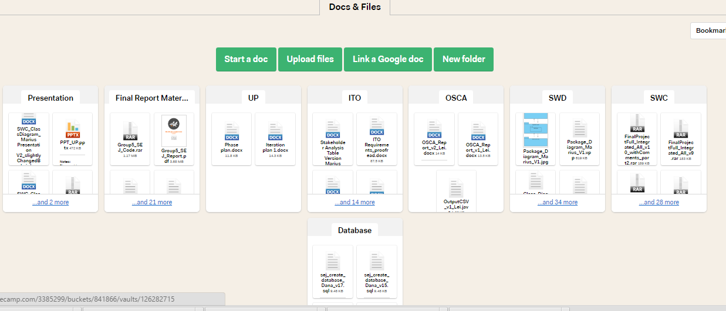

Slide 34
School project → Real life project
Work with other people
Take responsibility
Manage your time and resources
Have meetings – discuss
Ask for feedback
Meet all requirements
Deliver a good quality product
Notes:
We took this project very seriously and therefore we got a feeling of what it’s like to work in a real-world company, where you have to work with other people, start with only the requirements and slowly develop an application. There were many things to take into consideration, and that is why we spend a considerable amount of time discussing what it is best to do, given the deadline that we had. Each of us has booked flight tickets, of course, but we’ve never wondered about what happens “behind the scene” and the changes that are made once a ticket is booked. That was what we as developers of this application had to deal with, fx: the seat becomes occupied, the flight has one more passenger for that class, a new customer is registered.

Slide 35
Conclusion
Put our knowledge and skills to use
Work efficiently in a team
Get the project done
Learn more
Understand more
Develop as individual & student
Notes:
We think that having conducted this project goes beyond the exam. It is not like we made this project, went to the exam, got a grade and then that’s it. We gained something out of it and it helped us improve ourselves, not only as students but also as individuals. Having to cope with these requirements and time pressure taught us how we should manage our time and resources in this type of situation. We also gained knowledge about the airline industry (fx we learnt the difference between a leg and flight), how to decide whether to proceed with a project or not (feasibility study) and the benefits of using an iterative and incremental process (UP).

Slide 36
The END
Thank you for your attention!

